Slide 1
ASP.NET

Slide 2
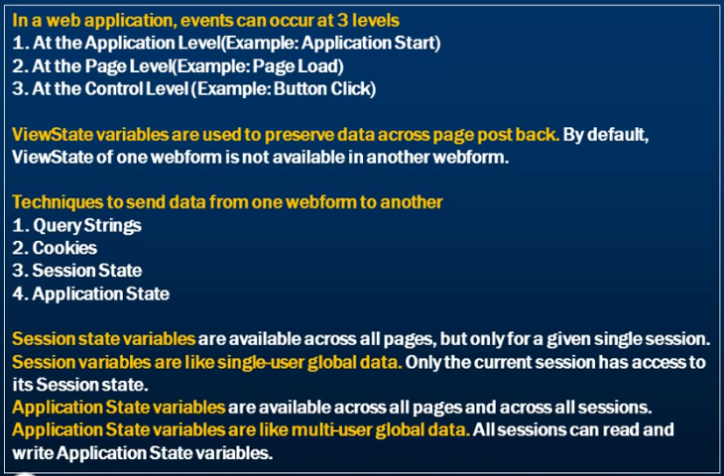
Events

Slide 3
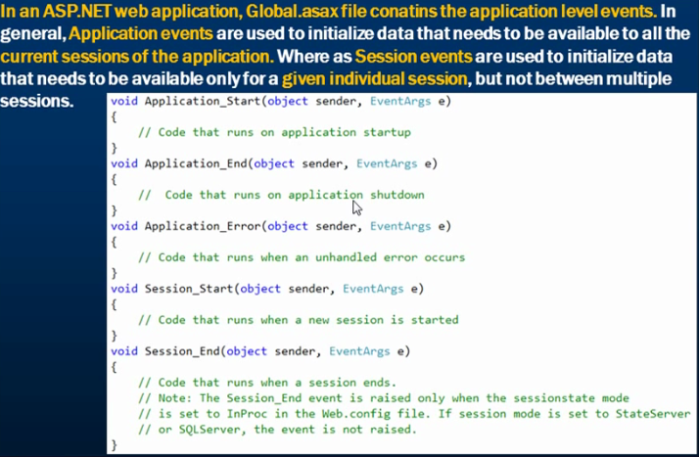
Application Level Events

Slide 4
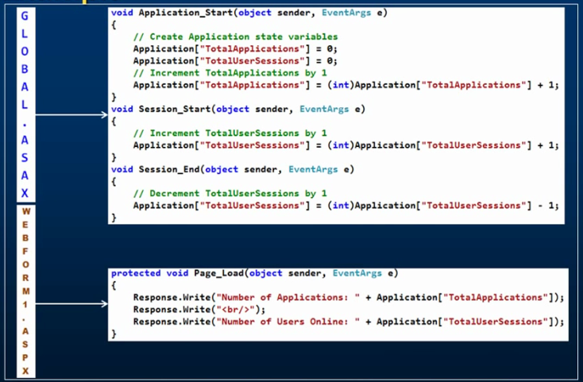
Example

Slide 5
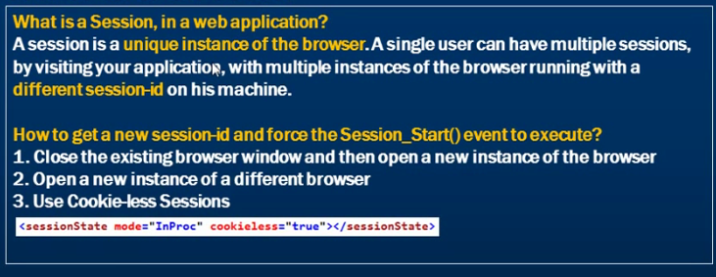
What is a session

Slide 6
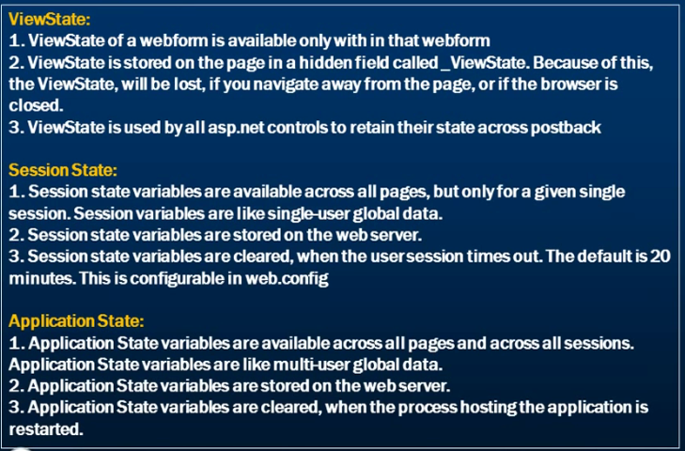
Difference Between Viewstate, Session State and Application State

Slide 7

ASP.NET Page Lifecycle event

Slide 8
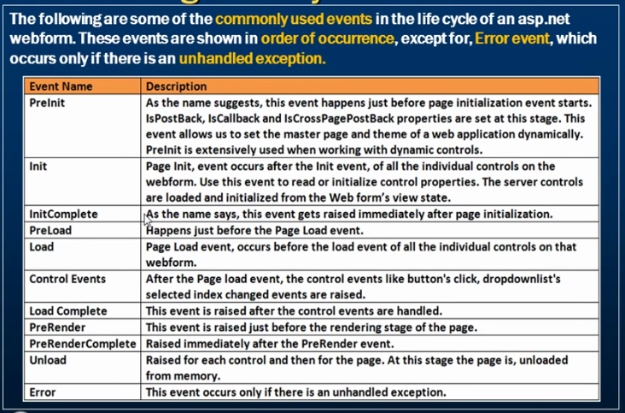
ASP.NET Event Life Cycle

Slide 9
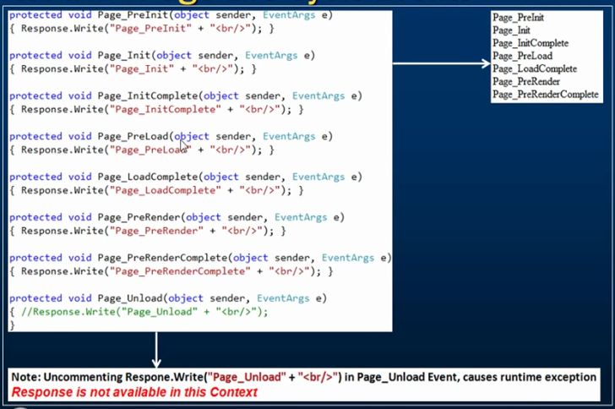
ASP.NET Page Life Cycle Events

Slide 10
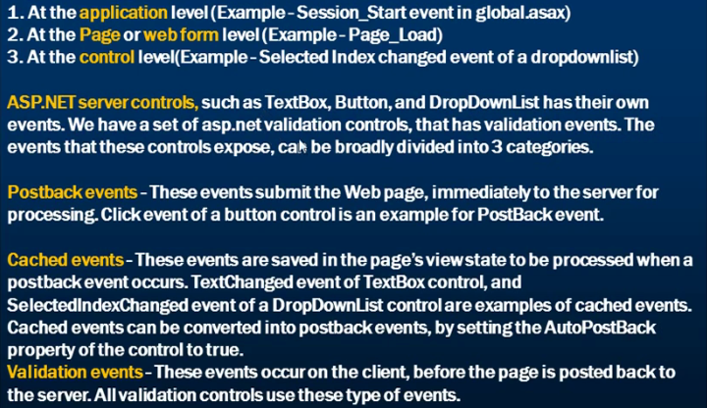
ASP.NET Server Control Events

Slide 11
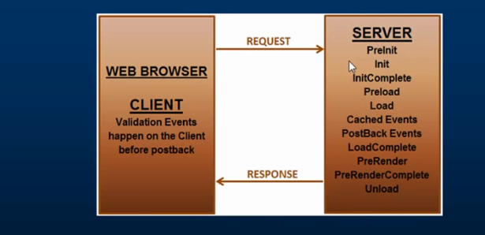
ASP.NET Server Control Events

Slide 12
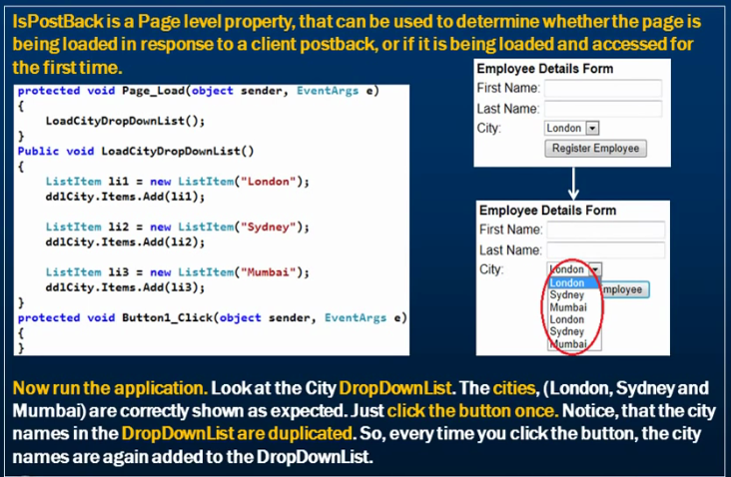
IsPostBackInASP.NET

Slide 13
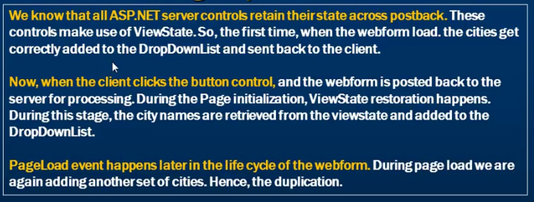
What is causing the duplication?

